Slide 1
Data repositories
Rafael Jimenez
Bioschemas agreement meeting
May 24-26, 2017

Slide 2
Data repositories subproject
Lead | EMBL-EBI (Henning Hermjakob)
Members | EMBL-EBI, ELIXIR UK
Delivery | Starting from 1 January 2017 for a period of 12 months
Funding | ELIXIR Bioschemas implementation study (7PMs)

Slide 3




Data repositories
…

Slide 4
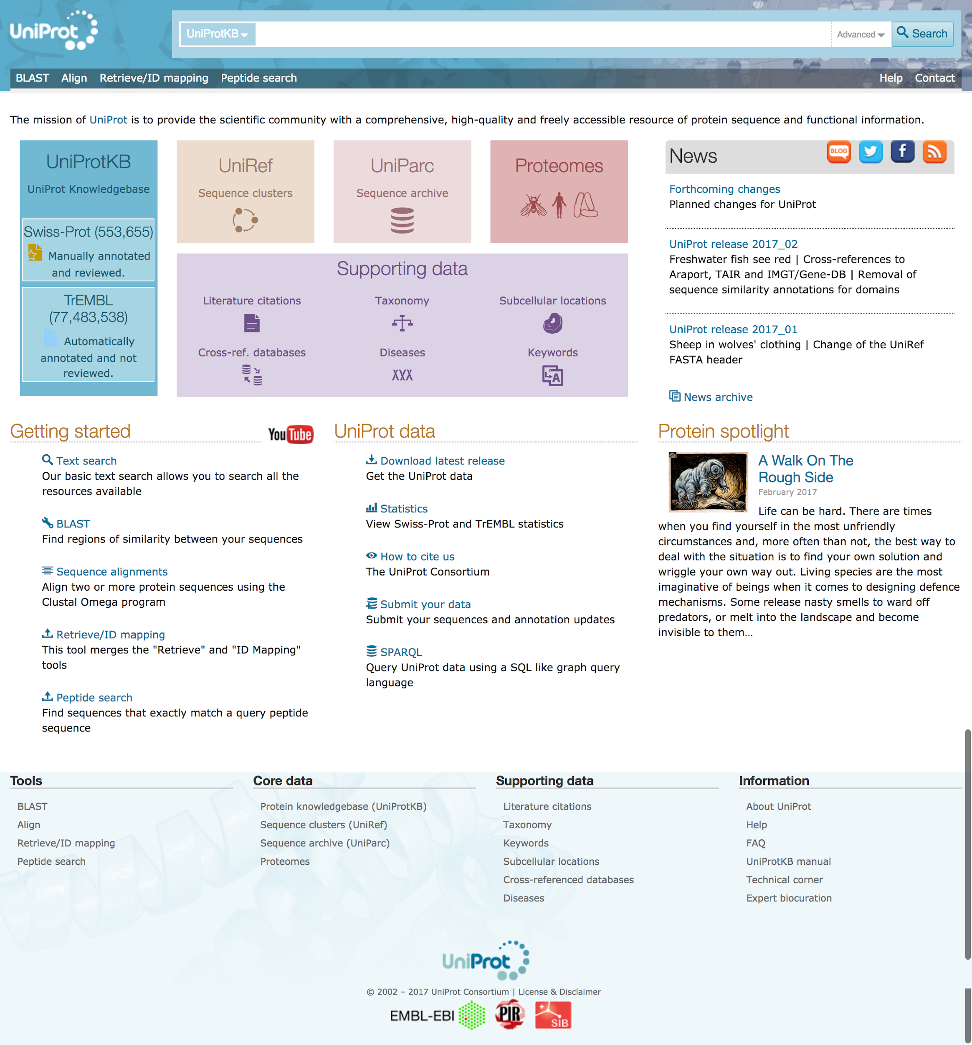
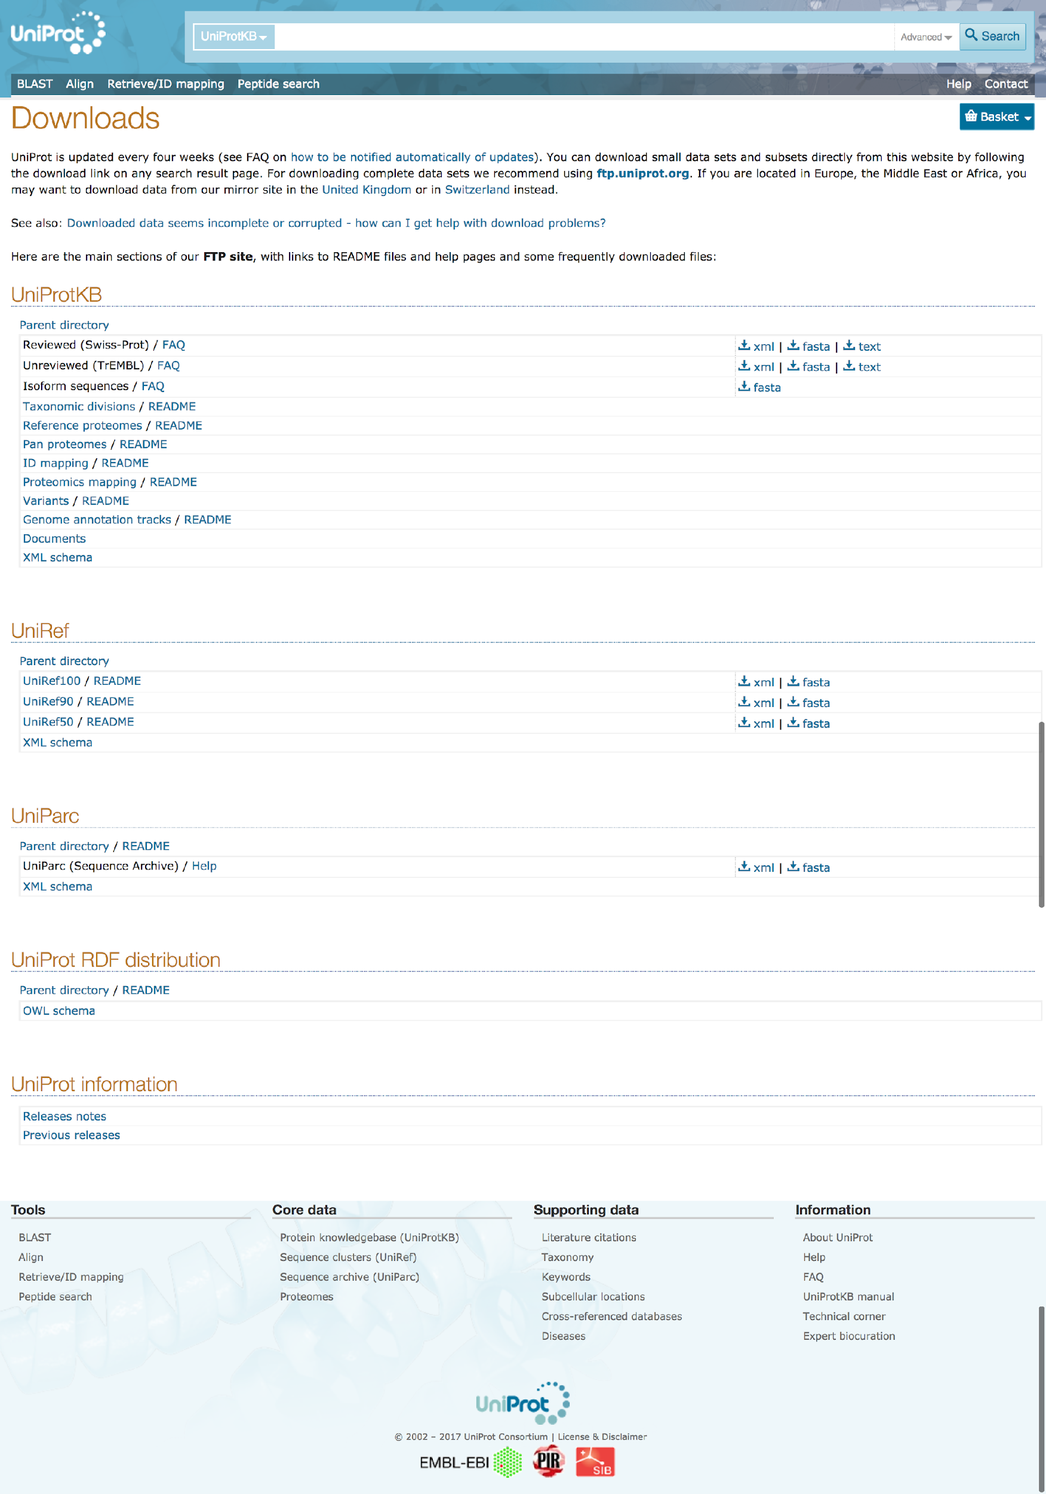
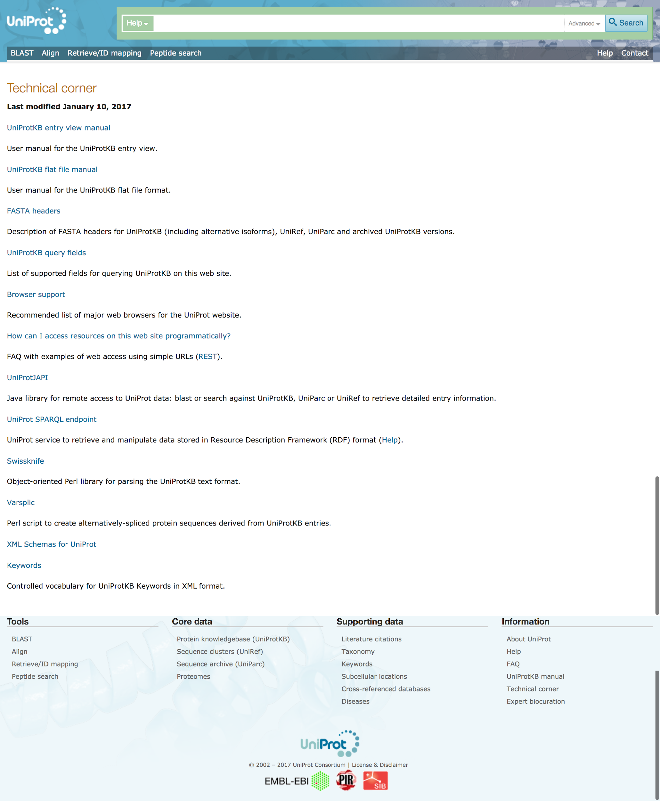
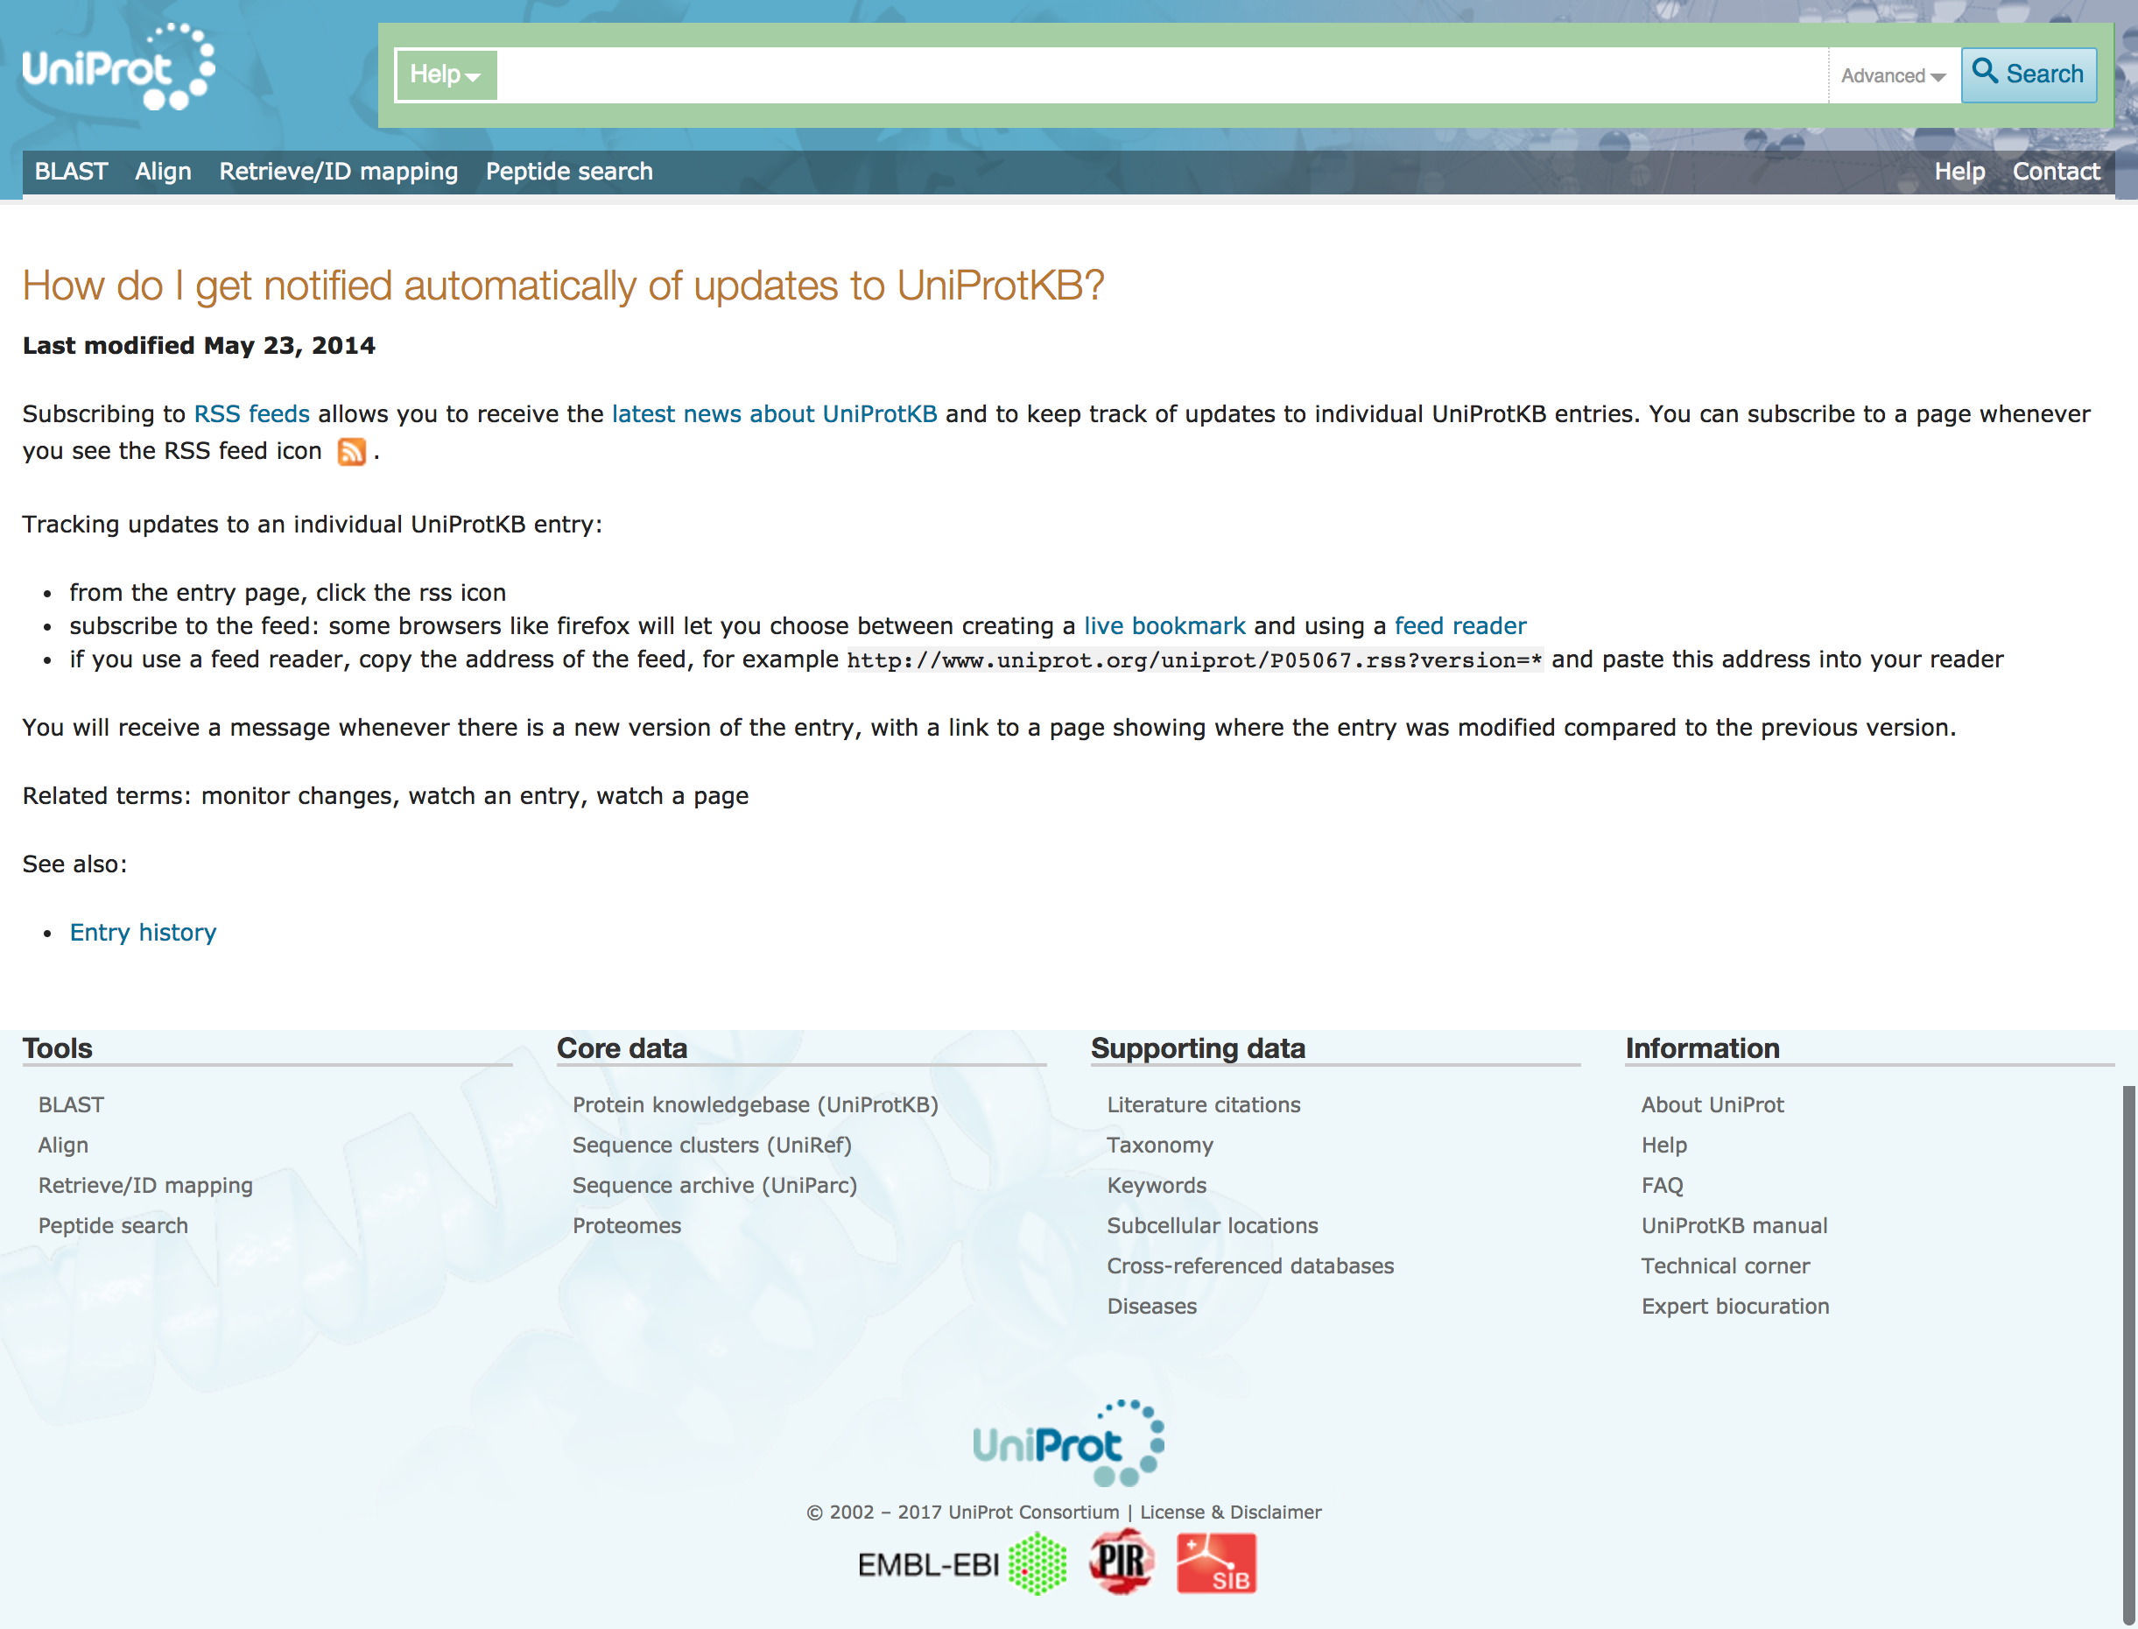
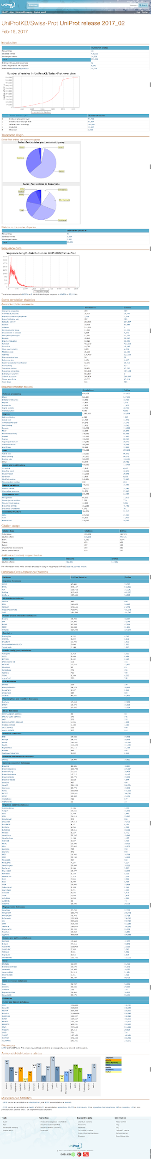
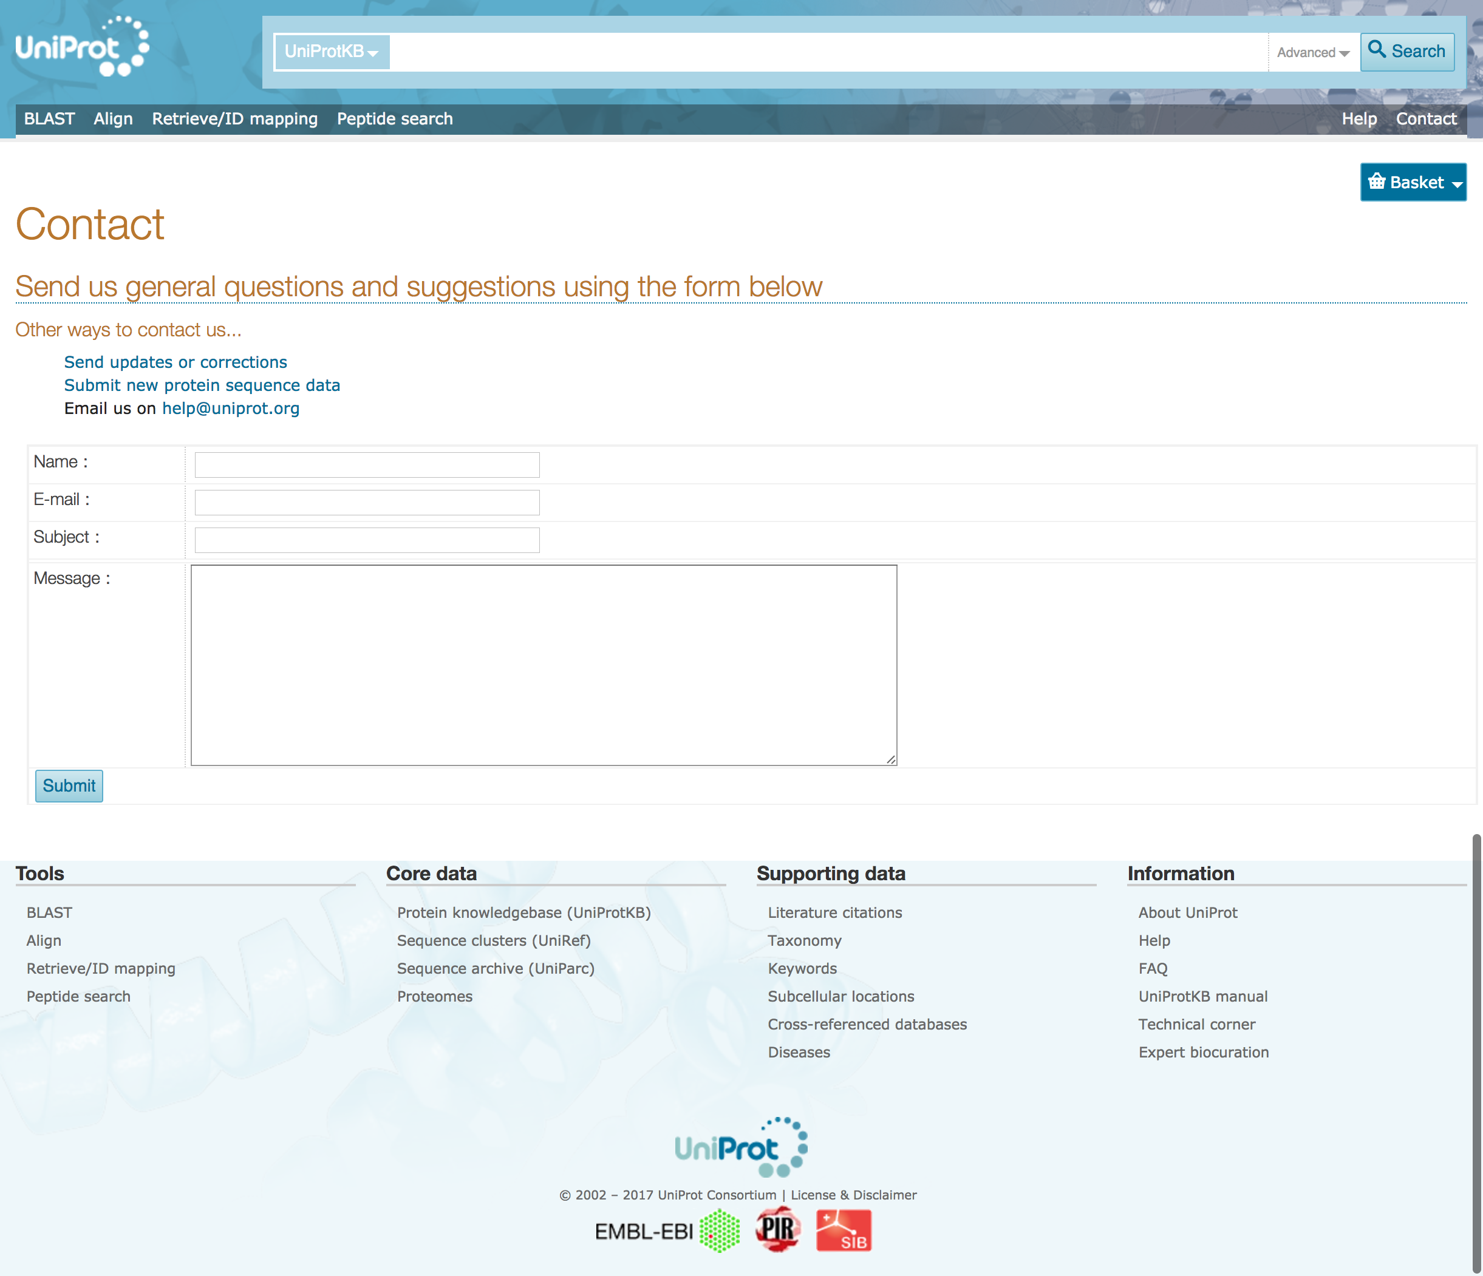
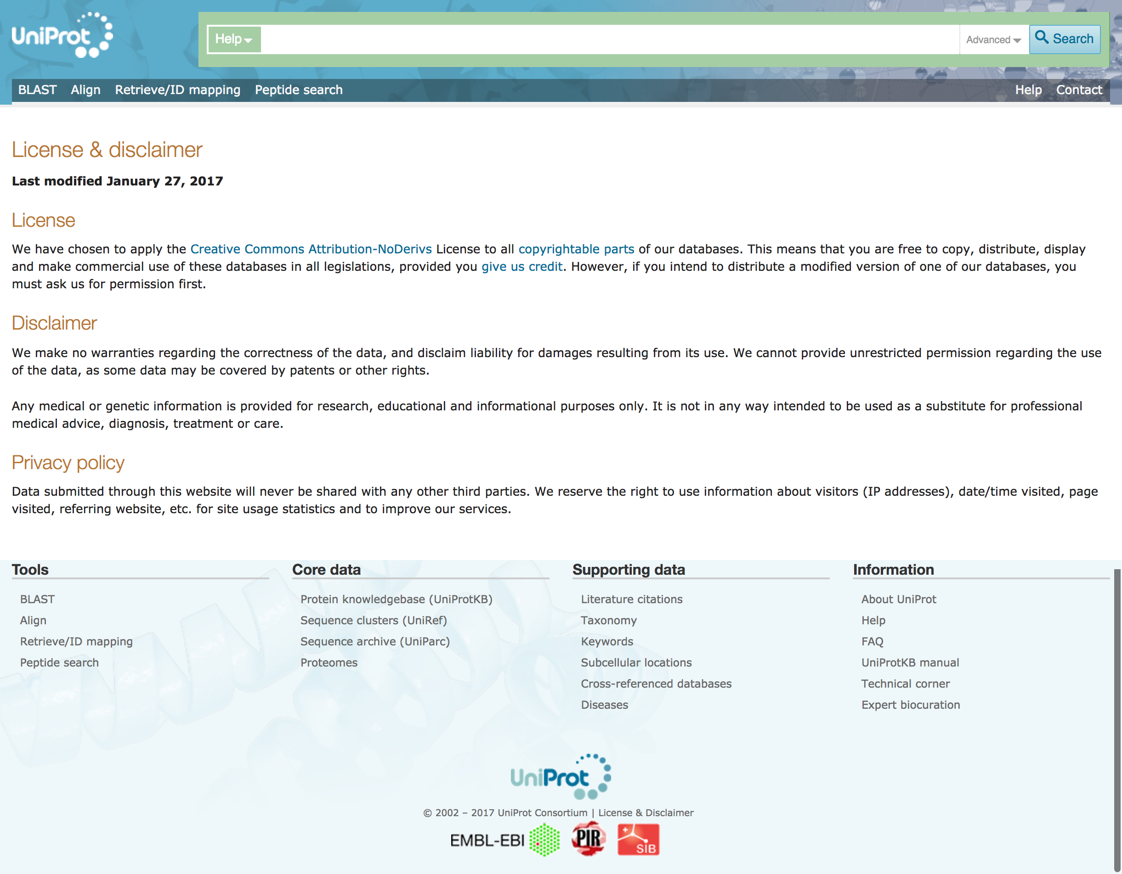
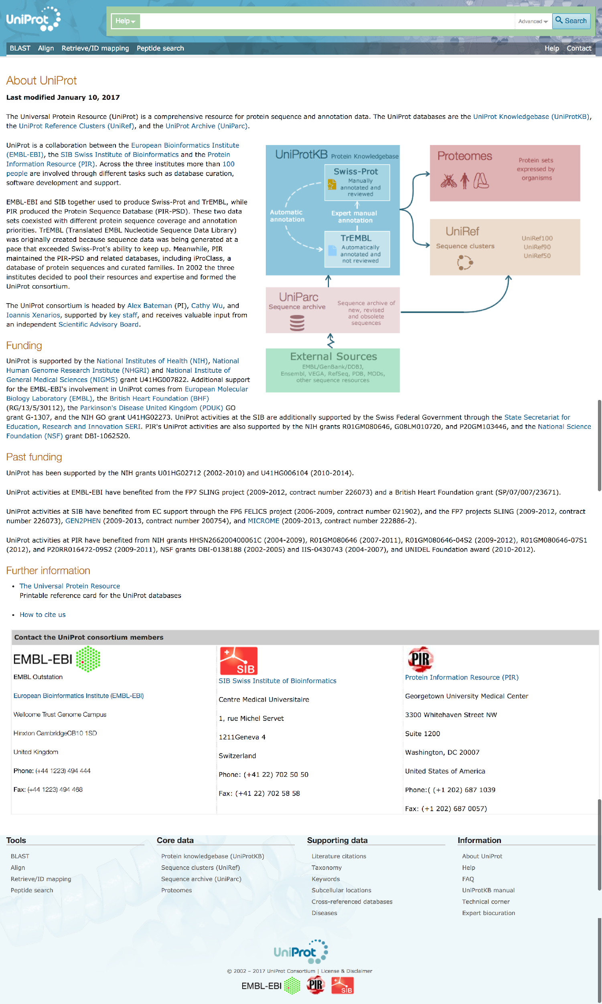
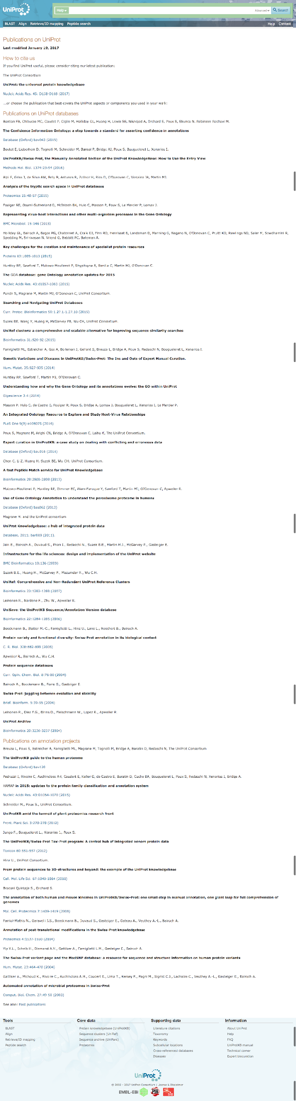
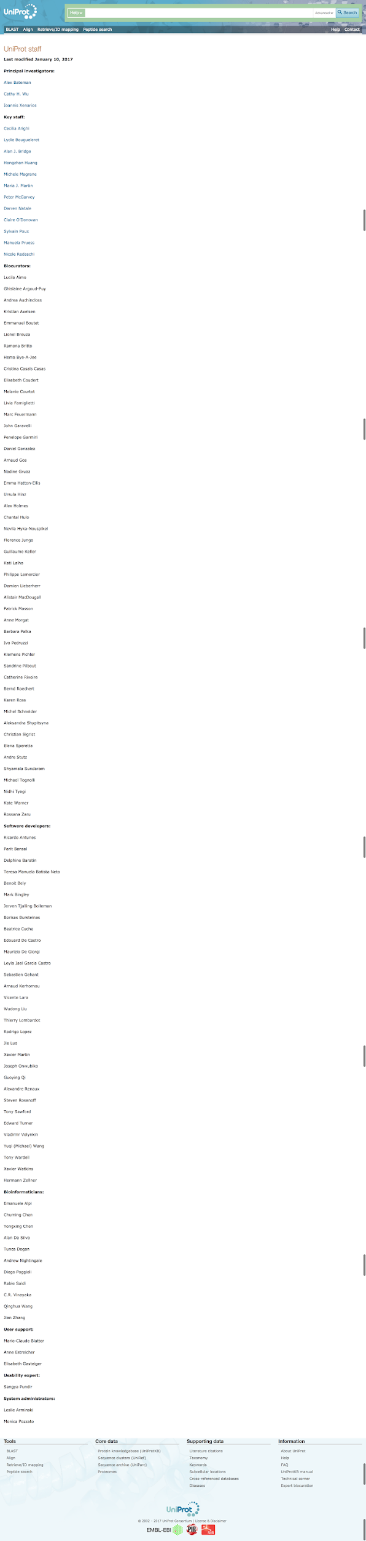
Description
Download
APIs
Release
Metrics
…
Contact
License
Funding
Citations
Authors

Slide 5



Registries of Data repositories
…
Identifiers.org
Bio.tools

Slide 6
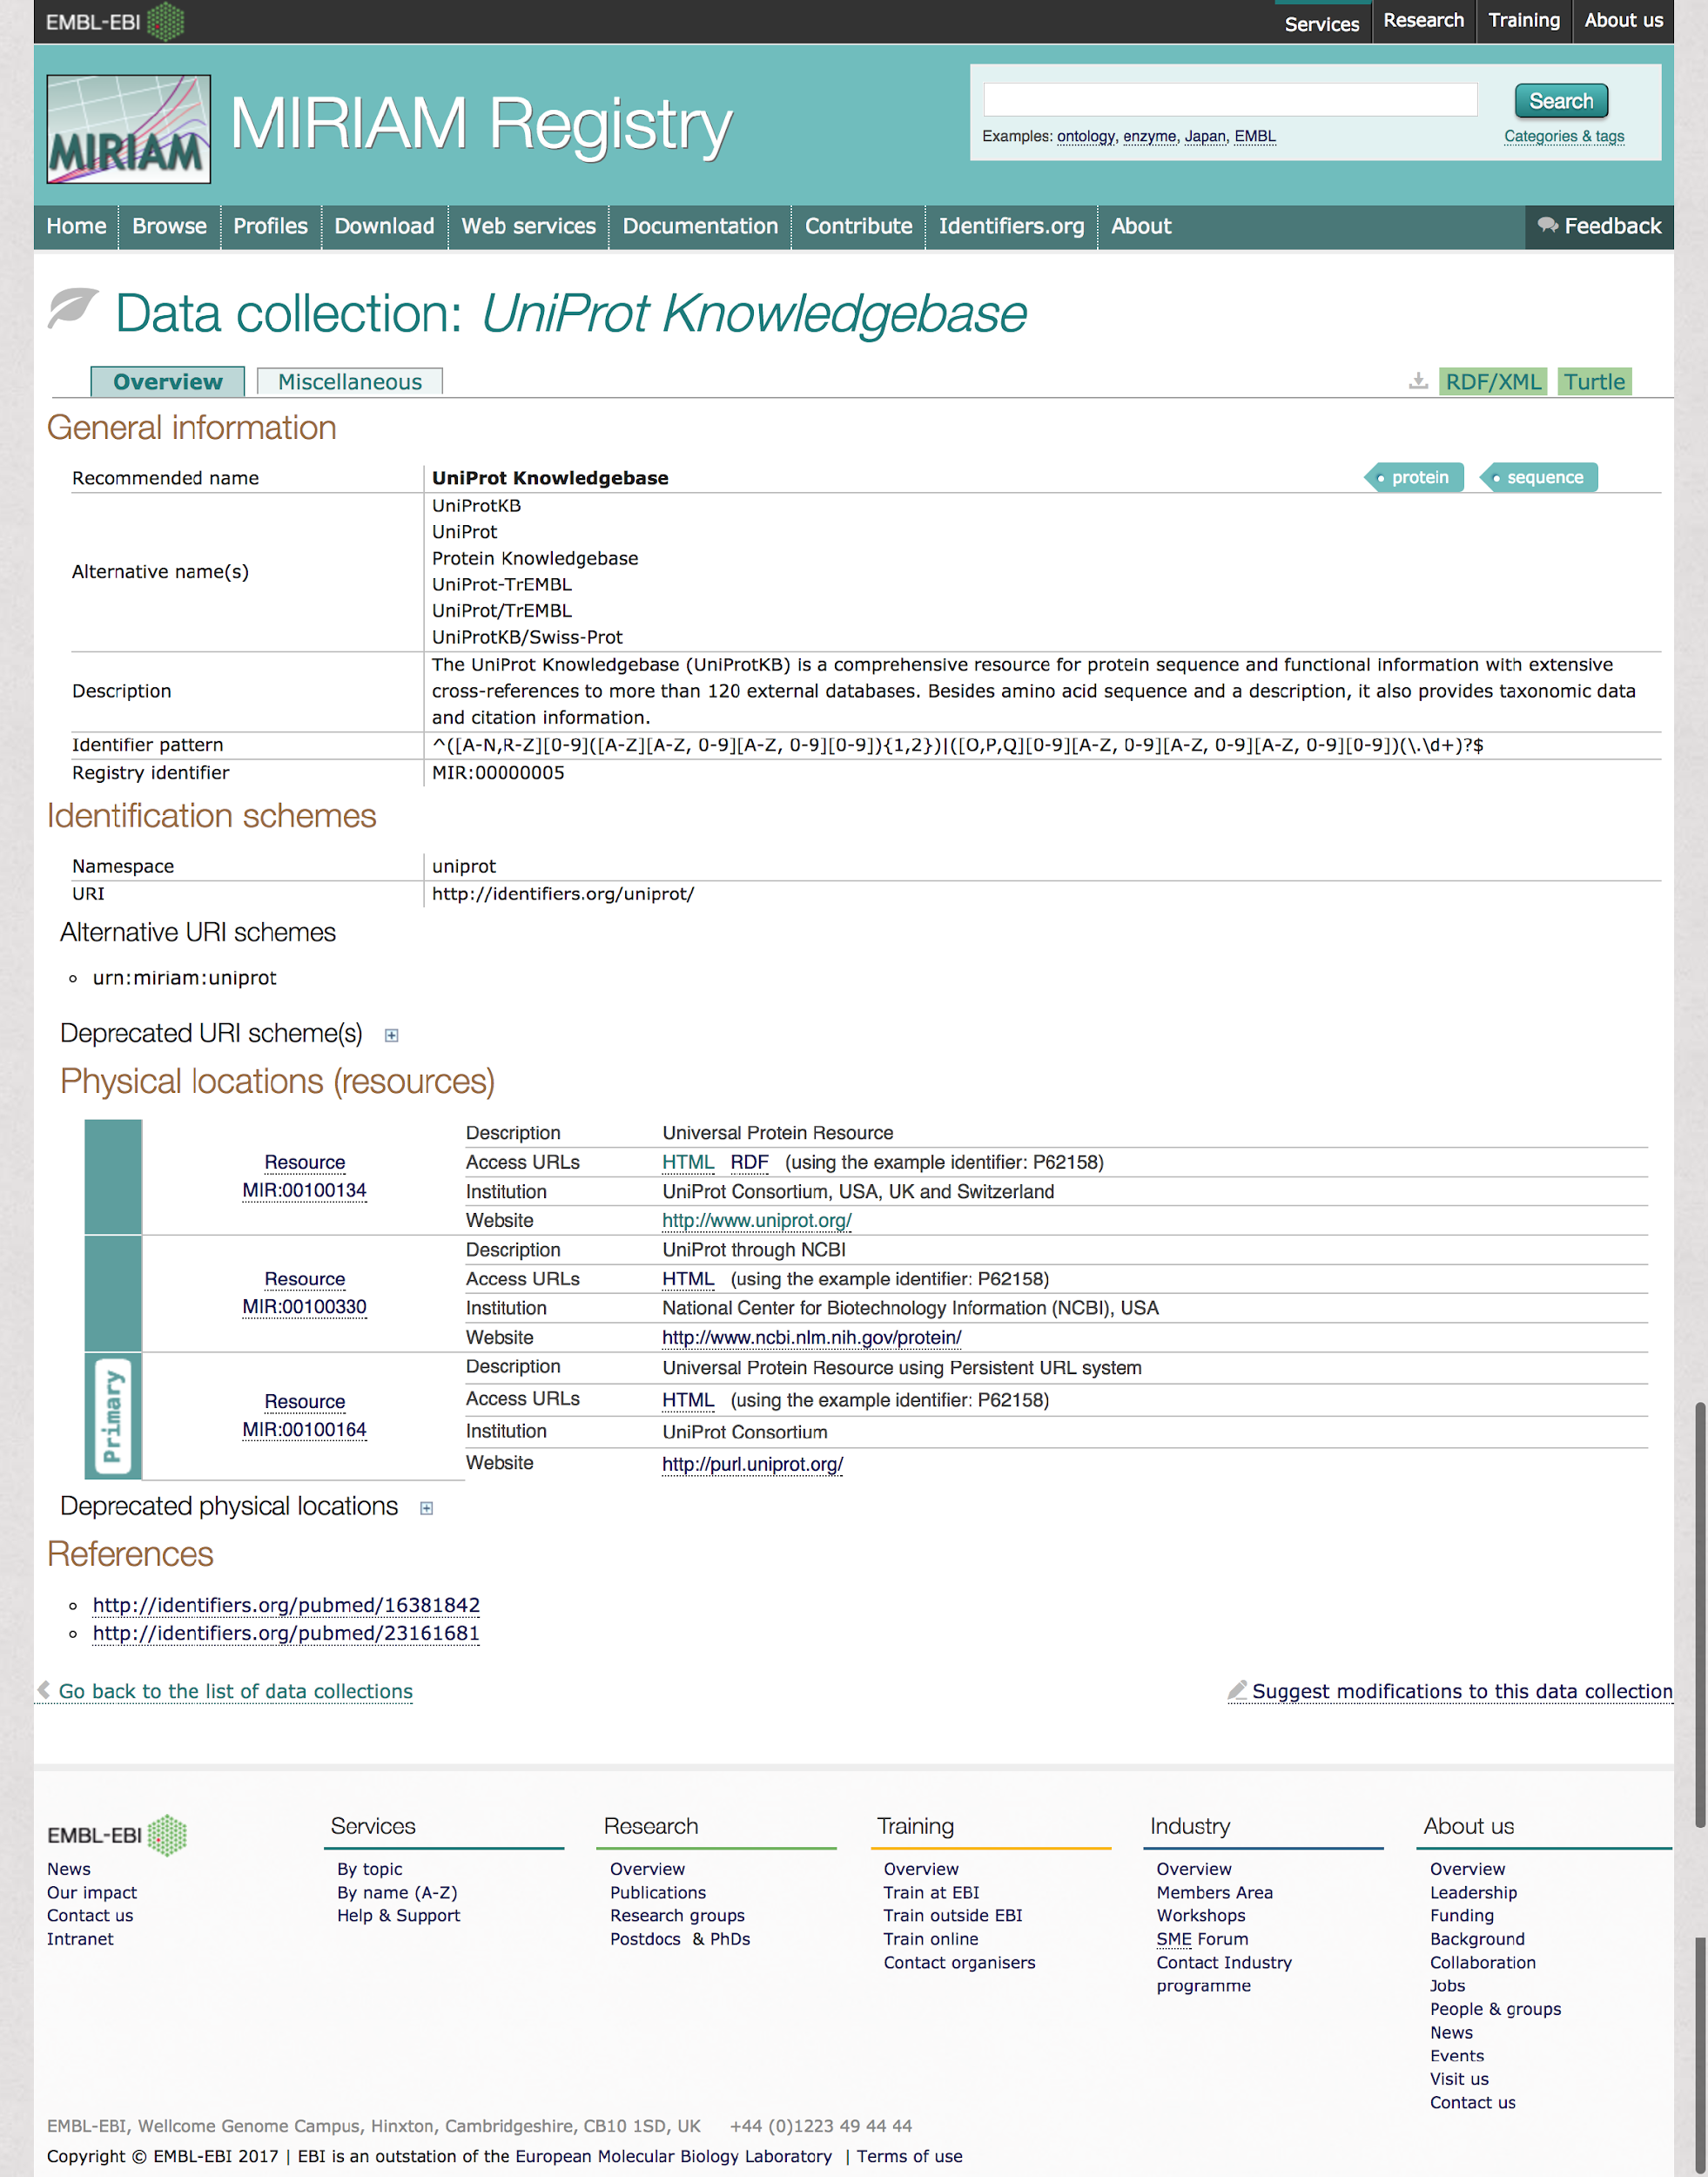
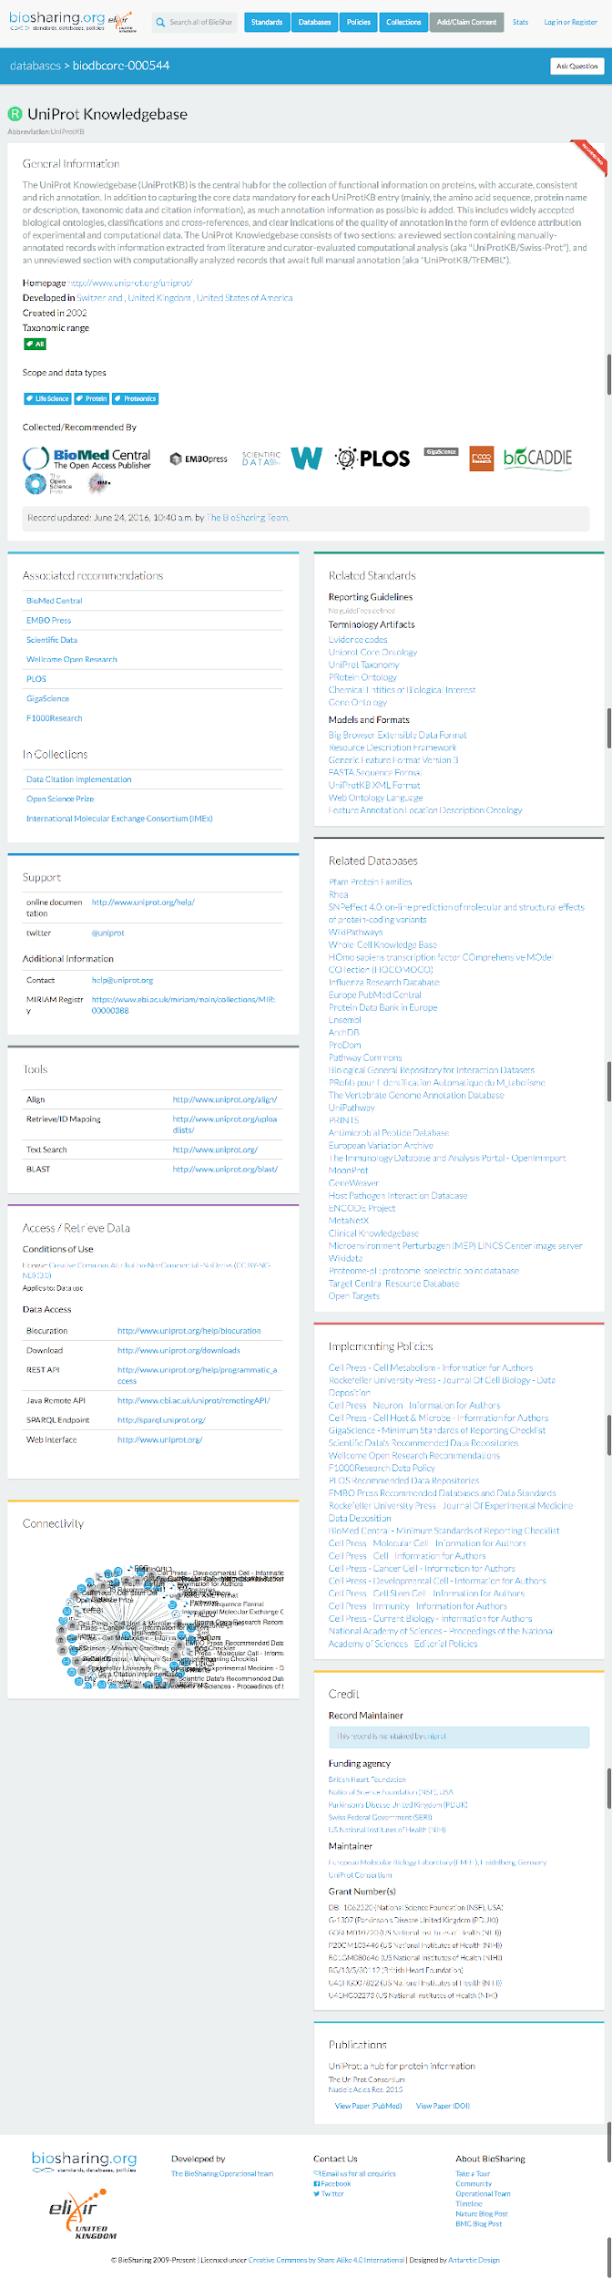
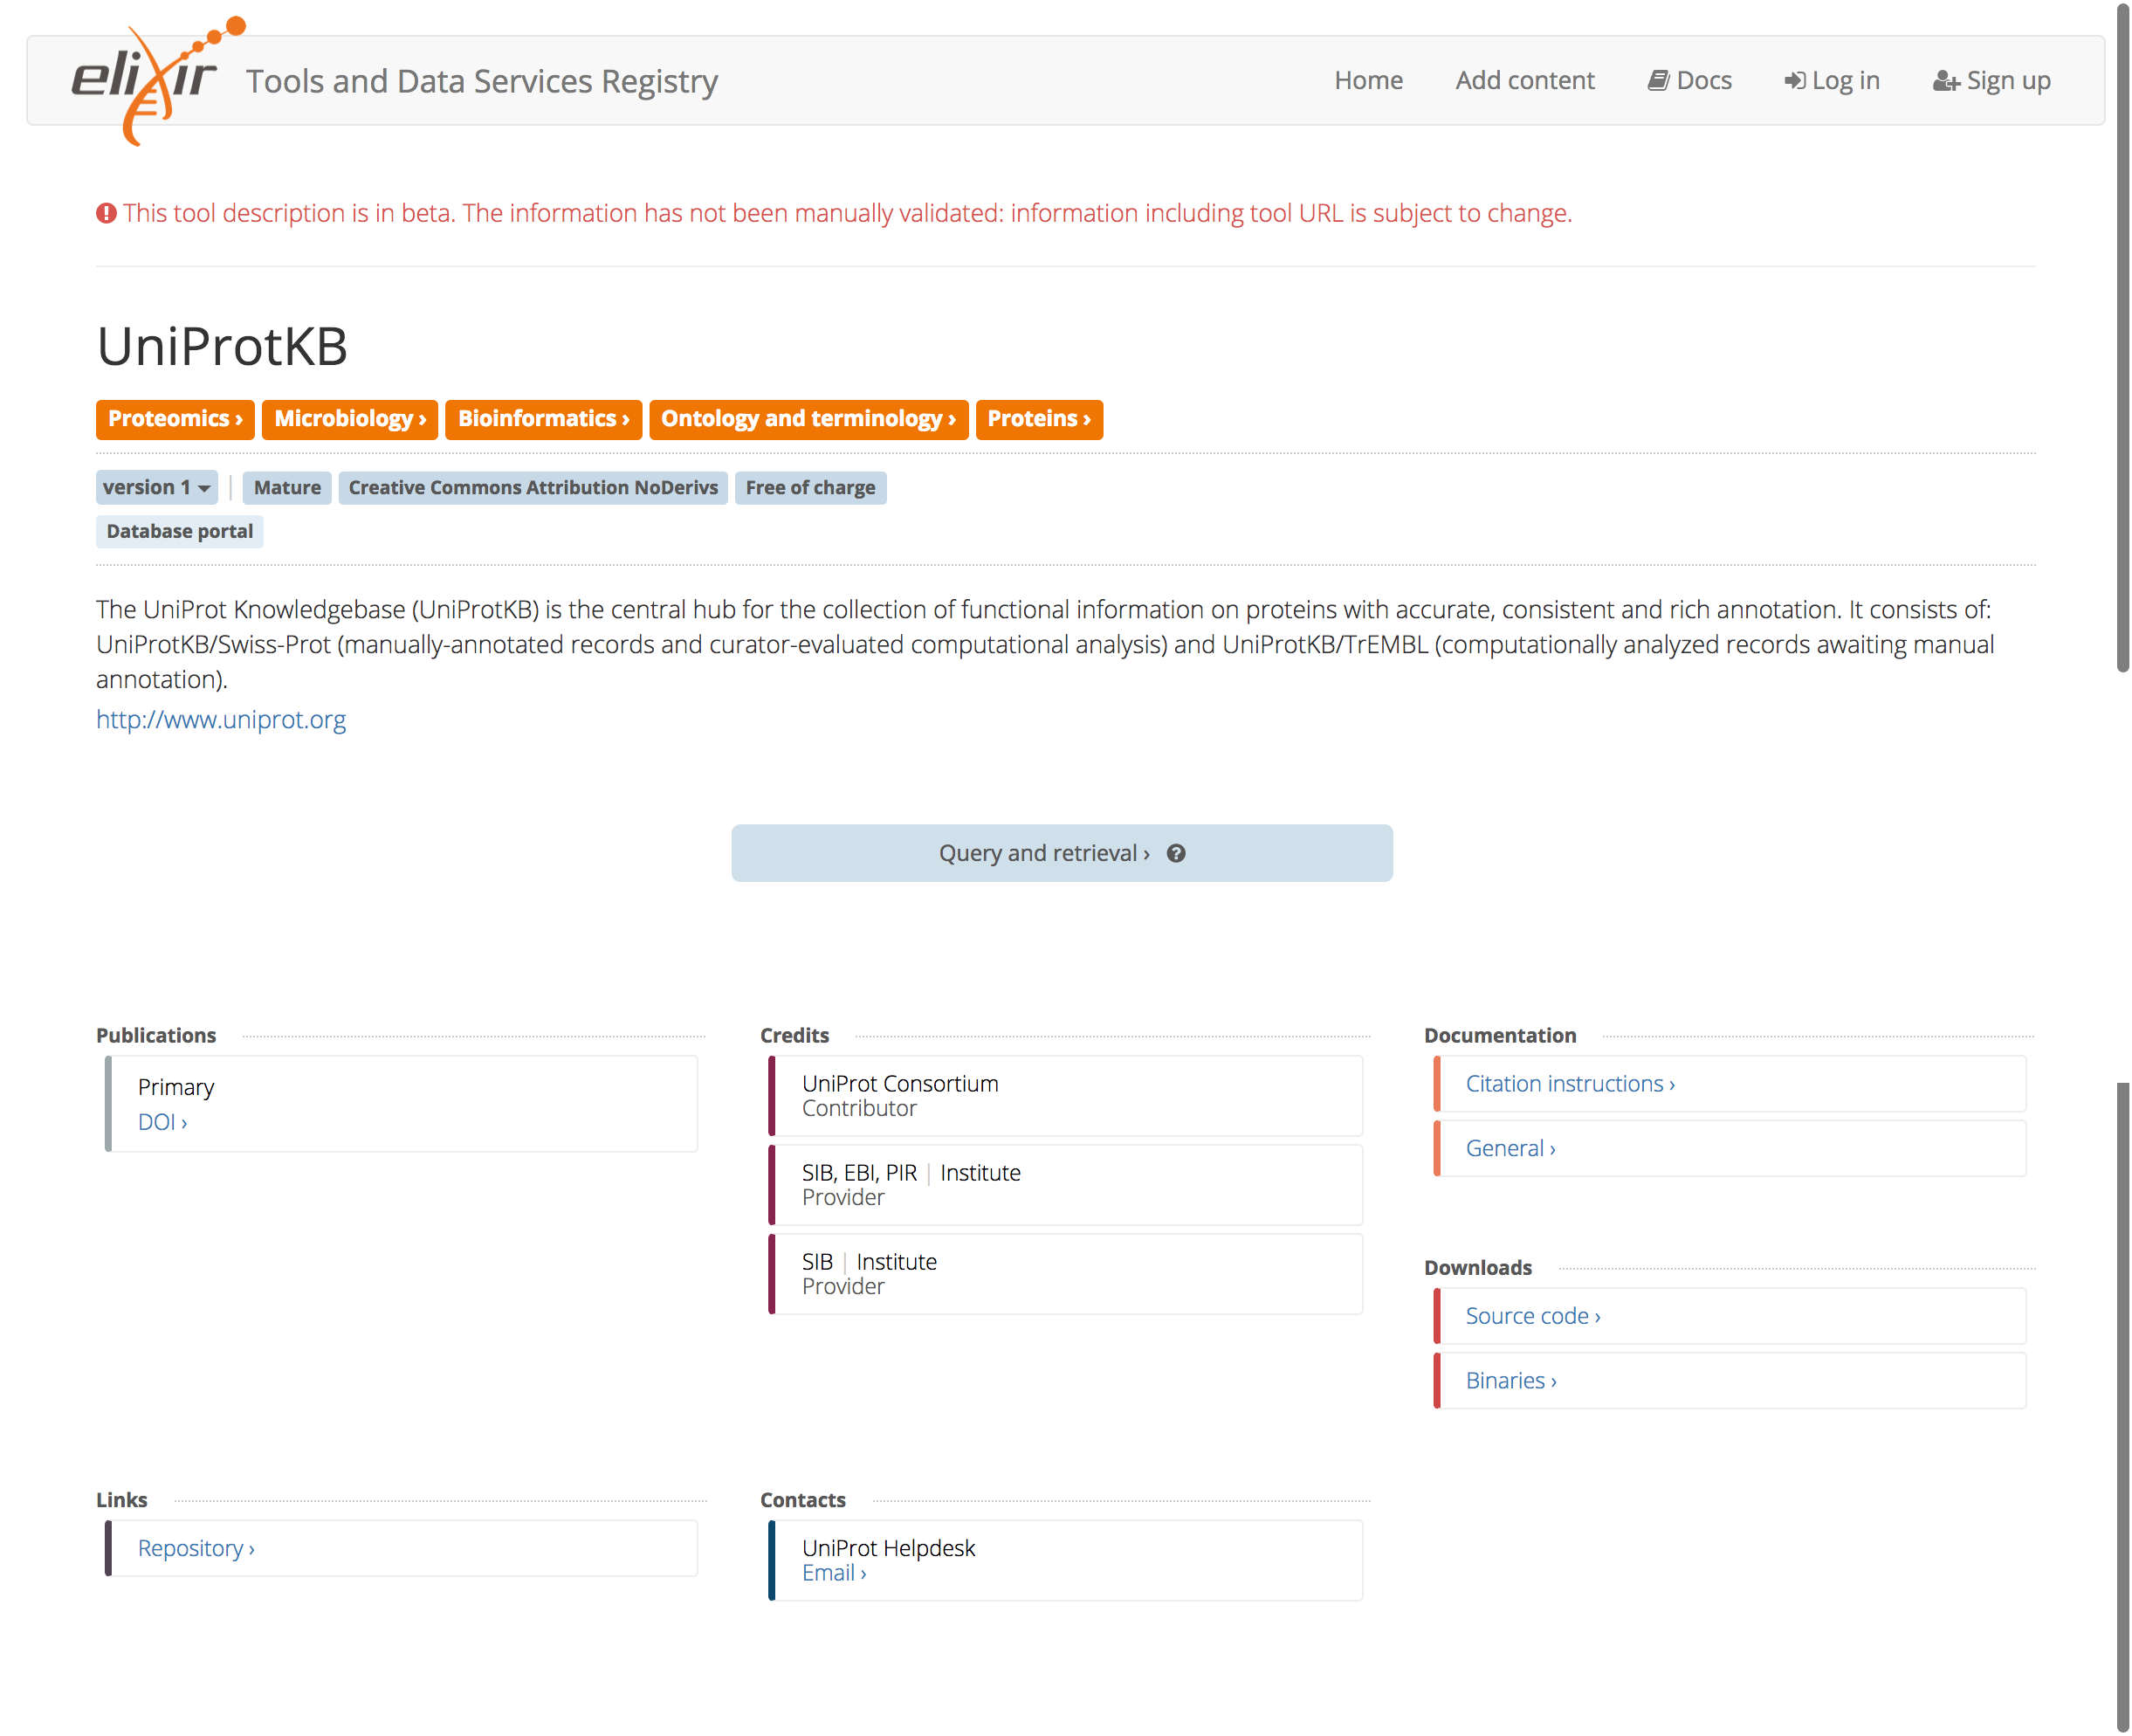
…
Identifiers.org
BioSharing.org
Bio.tools

Slide 7
Data repositories metadata
Citation
Identifiers
Release
Metrics
Tools
Interfaces

Slide 8
Progress

Slide 9
Define use case
Metadata crosswalk and mapping to schema.org
Data repositories
Metadata registries
Standards defining metadata
Dataset specification
Bioschemas specification
Define minimum properties based on “finding” use cases
Define cardinality and suggested controlled vocabularies
Align with existing best practices
Test with data repositories
Adoption by data repositories and registries
Applications
Done!
Planned for this workshop
After the workshop

Slide 10
Define use case

Slide 11
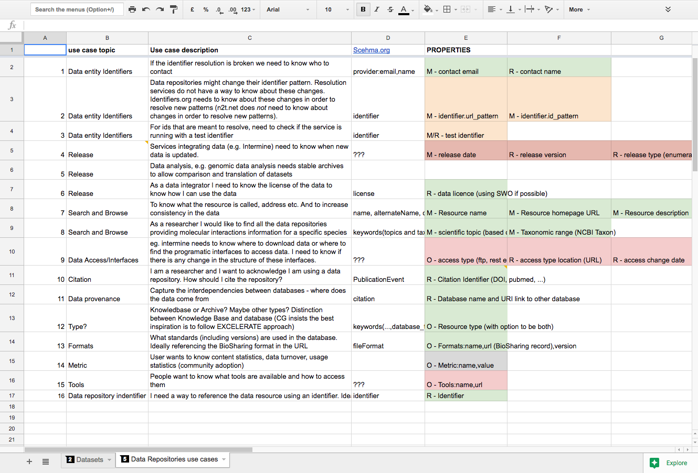

Slide 12
Mapping to schema.org and metadata registries

Slide 13
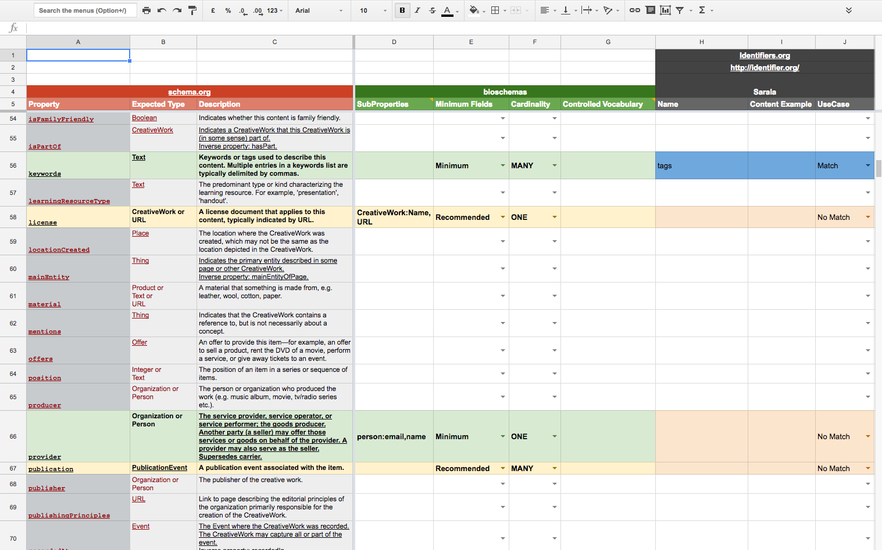

Slide 14
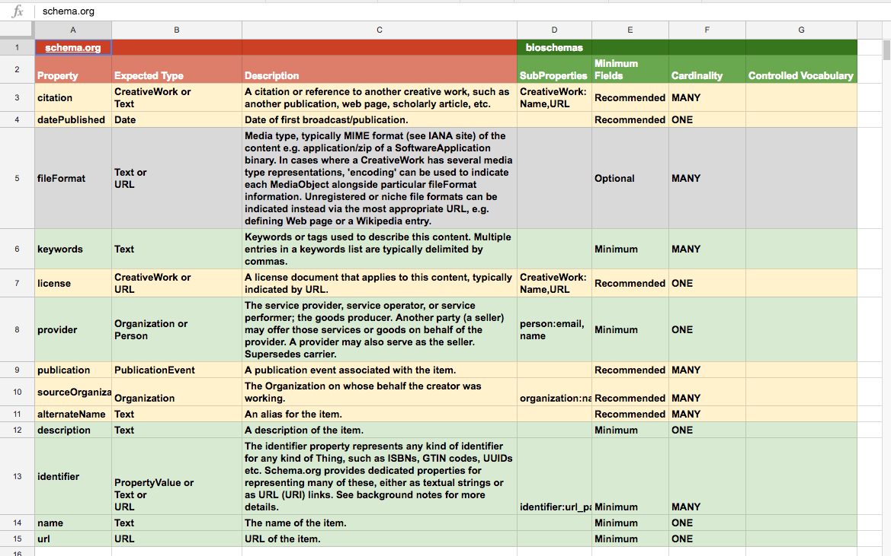

Slide 15
Mapped to schema.org
Not mapped to schema.org
Minimum
description
identifier
name
url
keywords
provider
Recommended
license
publication
sourceOrganization
alternateName
citation
datePublished
Optional
fileFormat
Group discussion
Schema.org discussion
Minimum
Entry identifier
Release
Recommended
Access
Optional
Metric
Tools

Slide 16
Mapping to data repositories
…

Slide 17
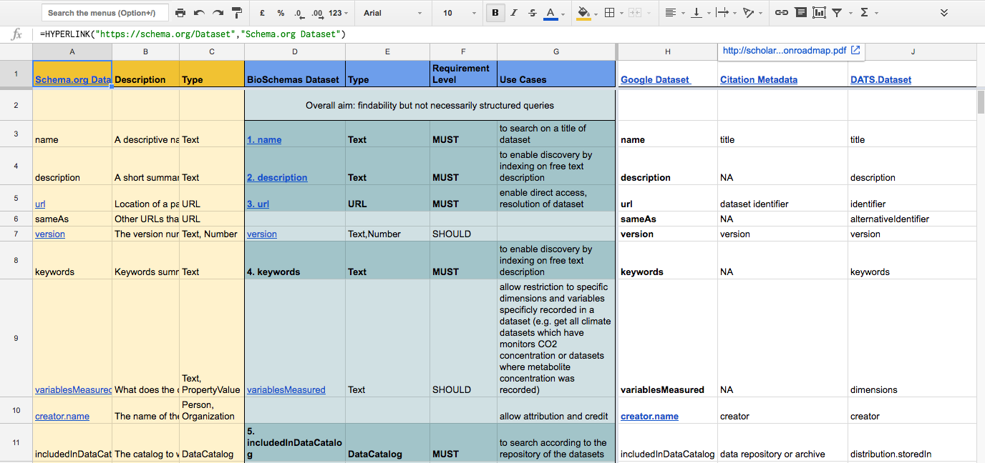
Mapping to Bioschemas dataset specification

Slide 18

Bioschemas data repositories specification
Specification
Data model
Minimum information
Controlled vocabularies
Cardinality
New (properties | types)
Documentation
Examples

Slide 19
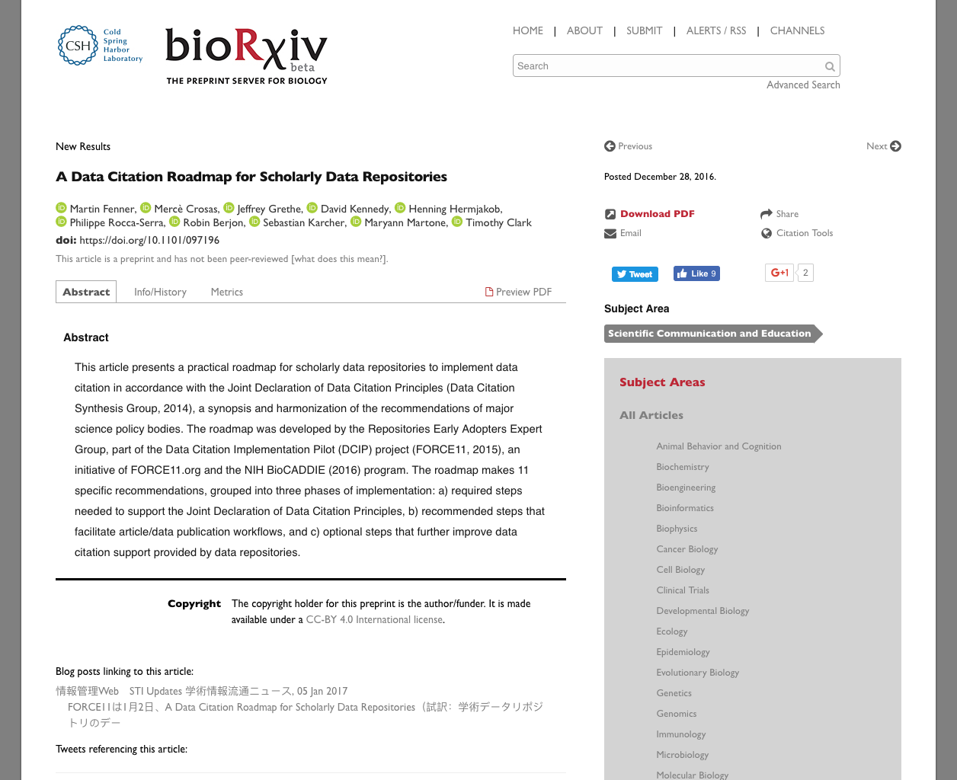
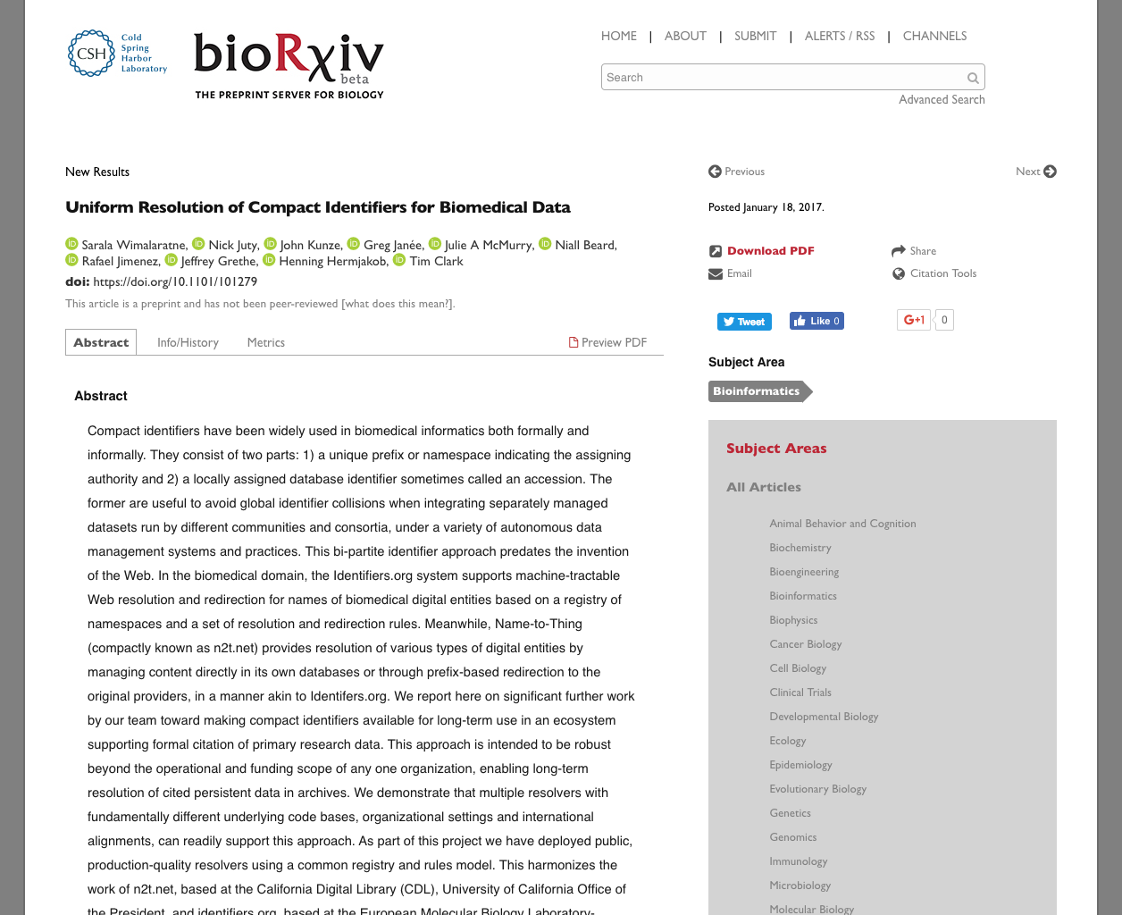
Alignment with best practices
…

Slide 20
Mockups: data repositories and registries
…
…
Identifiers.org
Bio.tools

Slide 21
Description
Download
APIs
Release
Metrics
…
Contact
License
Funding
Citations
Authors

Slide 22
Thanks to
Sarala Wimalaratne
Peter McQuilton
Haydee Artaza
Henning Hermjakob
John Kunze

